Slide 1
TypeScript: JavaScript that scales
Notes:
JS wasn’t originally designed for large scaled applications.
So, there are solutions to treat JavaScript as the intermediate language of the web and compile other languages to it, for example: CoffeeScript, Kotlin, ClosureScript, etc.
However, they are not successful so far.
Because you cannot make everyone happy when you target an ecosystem from another ecosystem.
As Anders Heijsberg said: You want to be in the ecosystem, you want to be of the ecosystem.

Slide 2
What is TypeScript?
Statically typed superset that compiles to plain JS
Open source
Strong tools
Support latest JavaScript features (ECMAScript 2015) and future proposals (e.g. async functions and decorators)

Slide 3
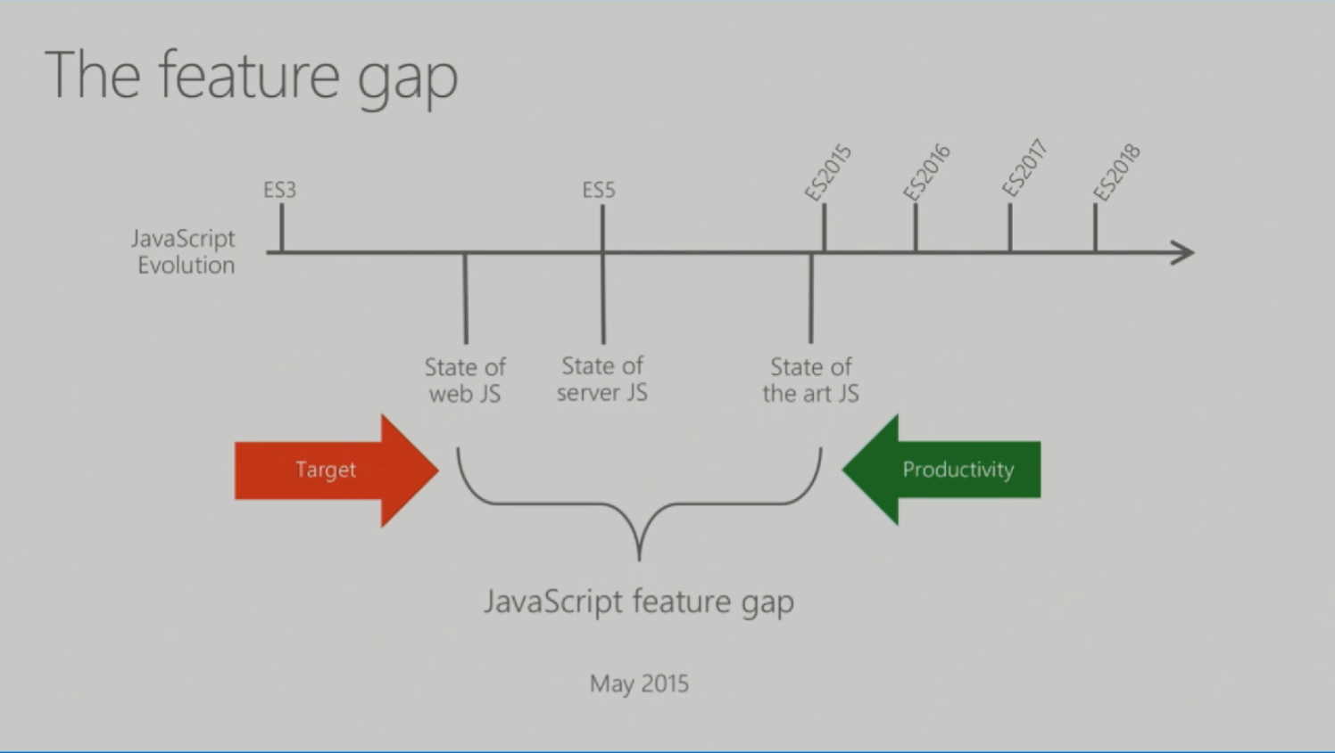

Slide 4
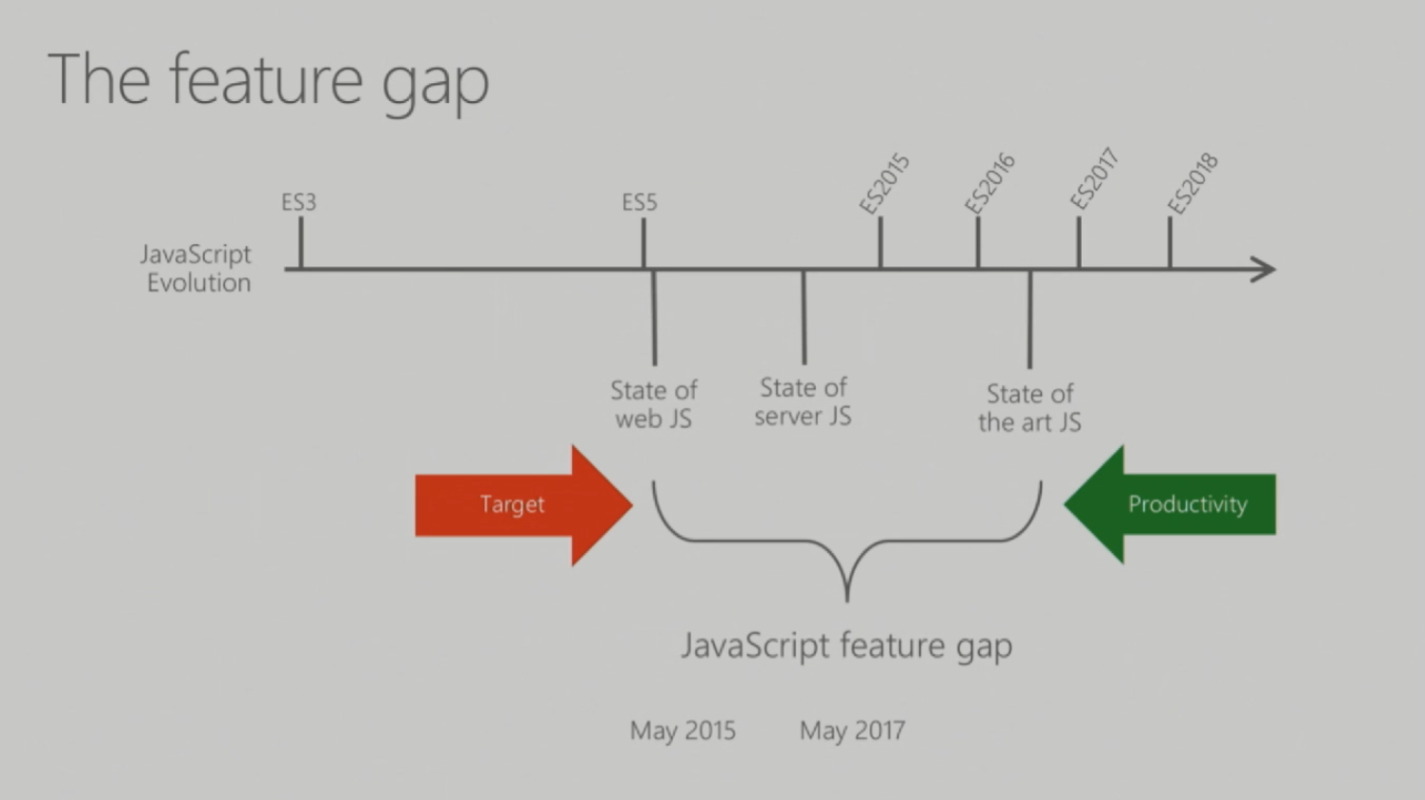
Notes:
The gap continues to be there and perhaps will always be there.
Because by the time browsers in all platforms catch up, the latest specifications has already moved

Slide 5
Basic TypeScript
VSCode is an free and open source editor from Microsoft. It is written in TypeScript.
If you don't want to use VSCode, you can use other editors like Sublime, Atom. They all have plugins for TypeScript.
Demo

Slide 6
Switzerland for Frameworks
TypeScript strives to support all modern frameworks: React, Angular 2, VueJS
React support
TSX: TypeScript version of JSX – a syntax extension of JavaScript used by React
TypeScript compiler understands JSX/TSX syntax so you can navigate and refactor React components
React components can greatly taking advantages of TypeScript interfaces to define their properties and state types
Demo

Slide 7
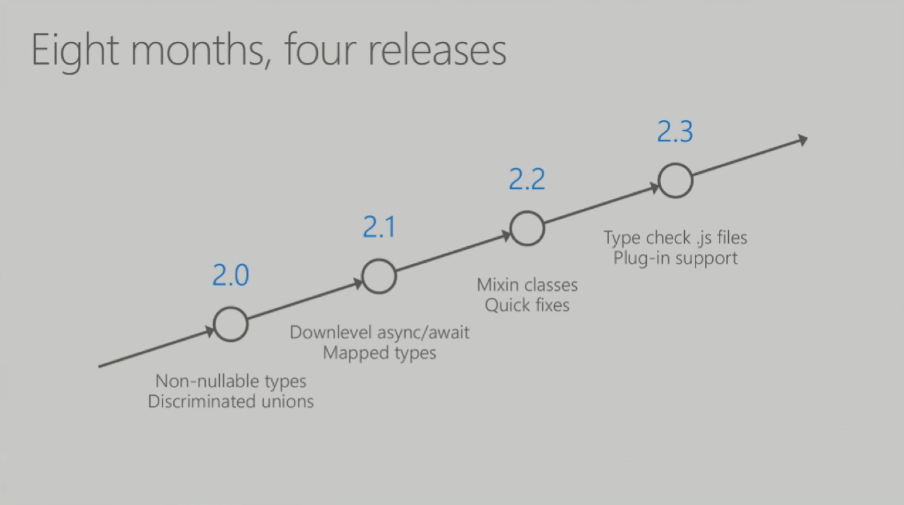
Notes:
The gap continues to be there and perhaps will always be there.
Because by the time browsers in all platforms catch up, the latest has already moved

Slide 8
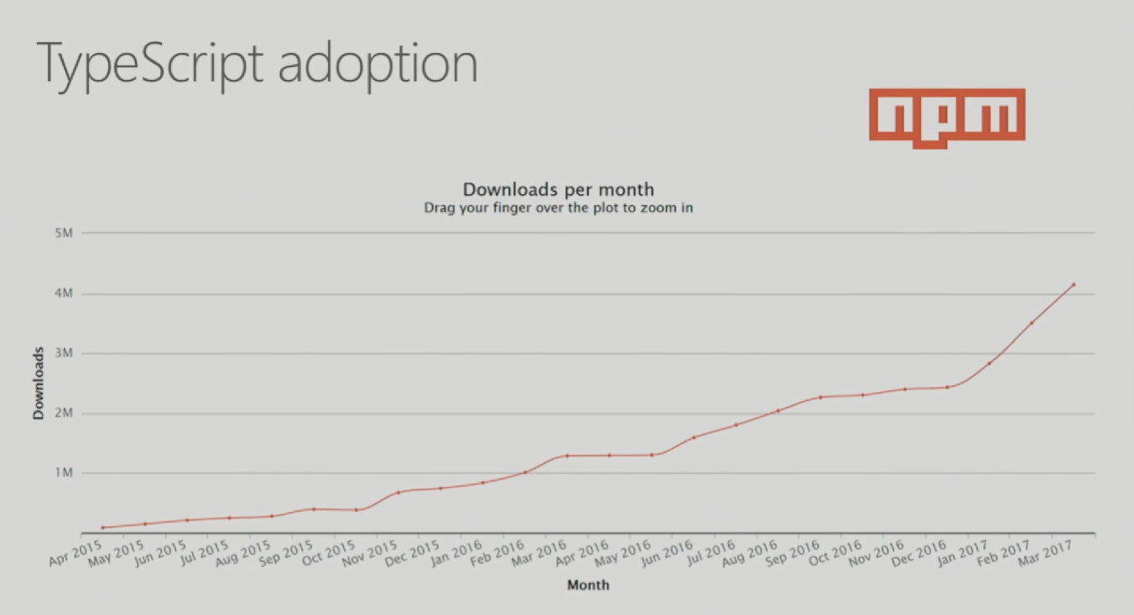
Notes:
The gap continues to be there and perhaps will always be there.
Because by the time browsers in all platforms catch up, the latest has already moved

Slide 9
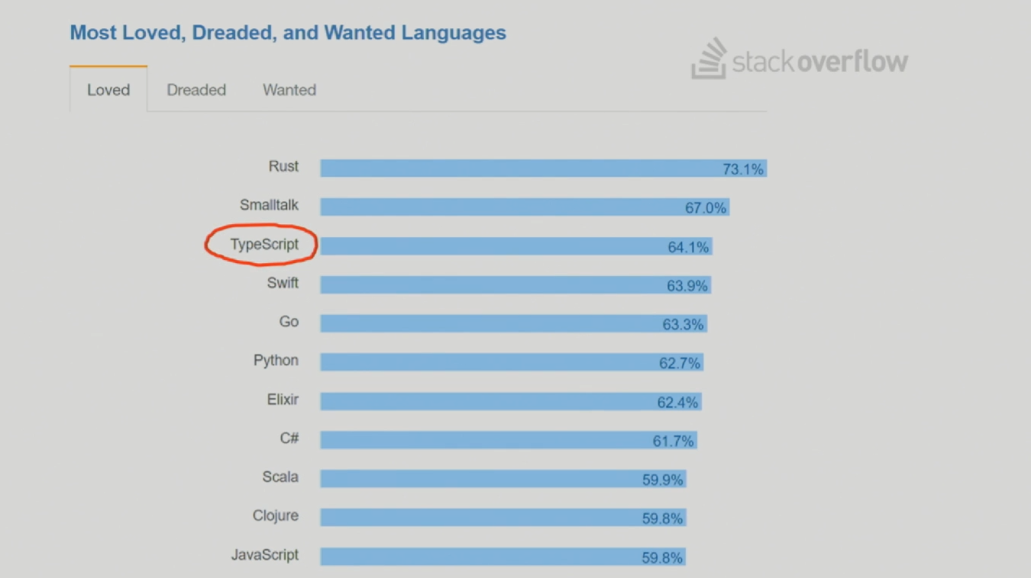
Notes:
The gap continues to be there and perhaps will always be there.
Because by the time browsers in all platforms catch up, the latest has already moved

Slide 10
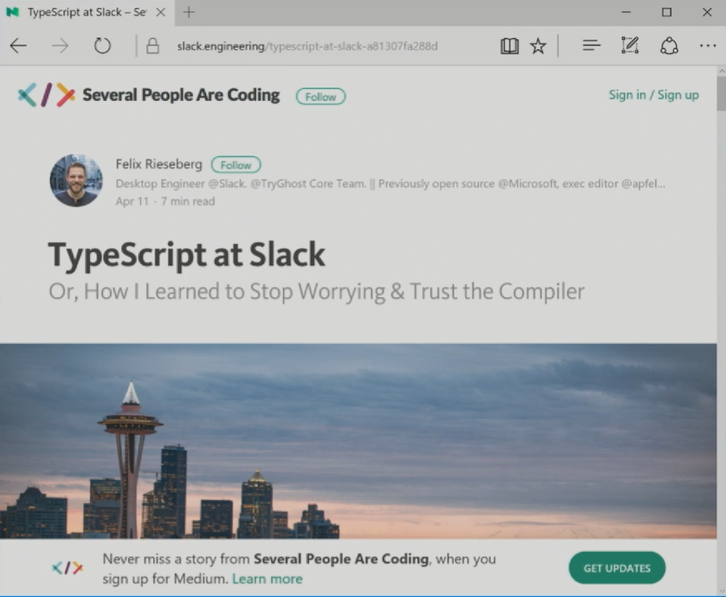
Notes:
The gap continues to be there and perhaps will always be there.
Because by the time browsers in all platforms catch up, the latest has already moved

Slide 11
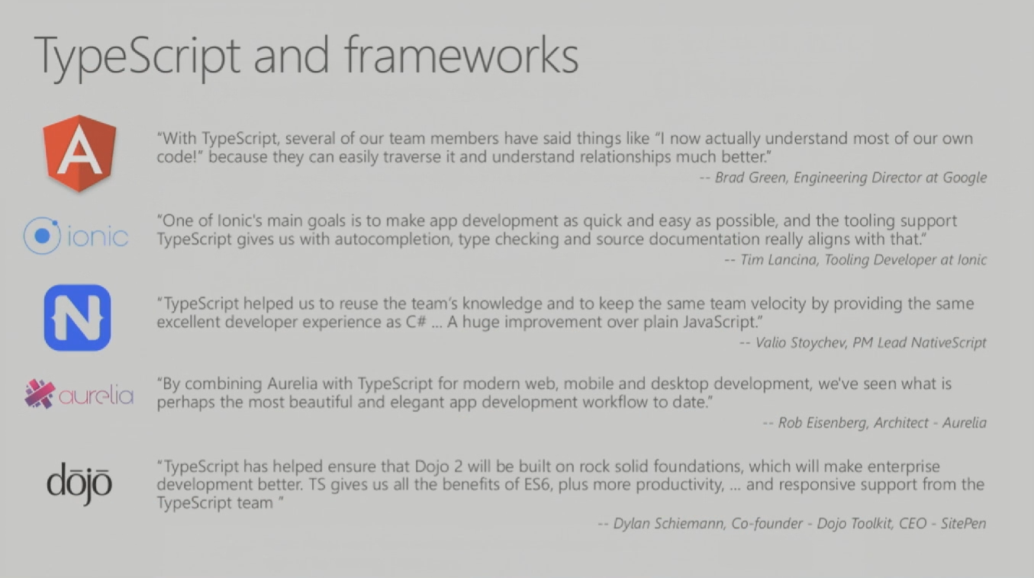
Notes:
The gap continues to be there and perhaps will always be there.
Because by the time browsers in all platforms catch up, the latest has already moved

